Slide 1


Slide 2

ANNOUNCEMENTS
Christmas meal
Red vs Blue
HTB University CTF

Slide 3



D0n’t D0 ill3gal Sh1t !

Slide 4

Notes:
Firebug student discount is all week and not just when we go out as a society

Slide 5
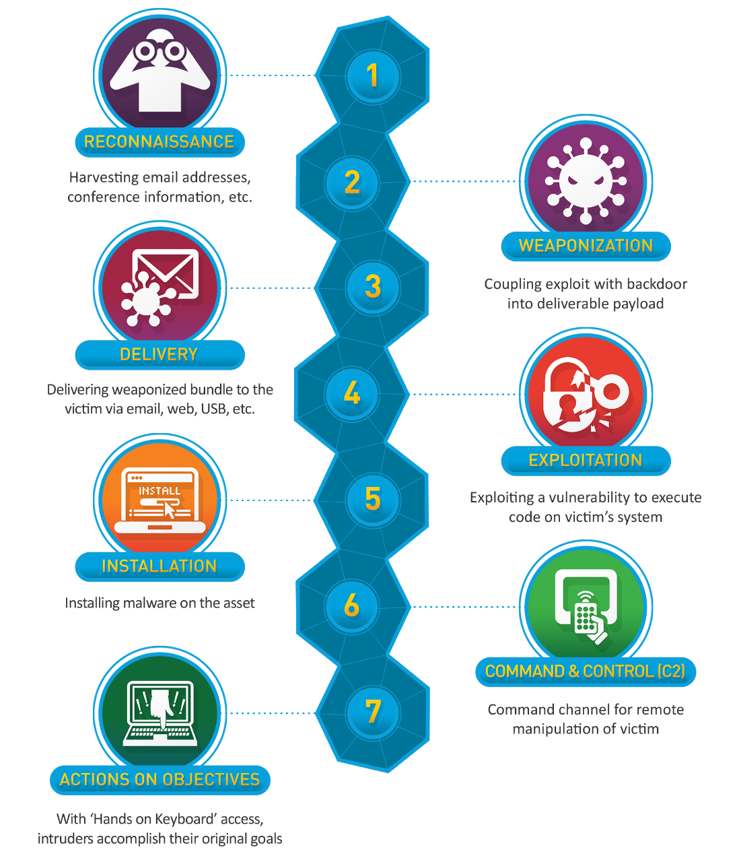
Lockheed
Martin
Cyber
Kill
Chain

Slide 6

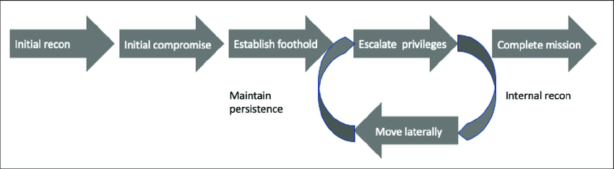
Mandiant Attack Lifecycle

Slide 7
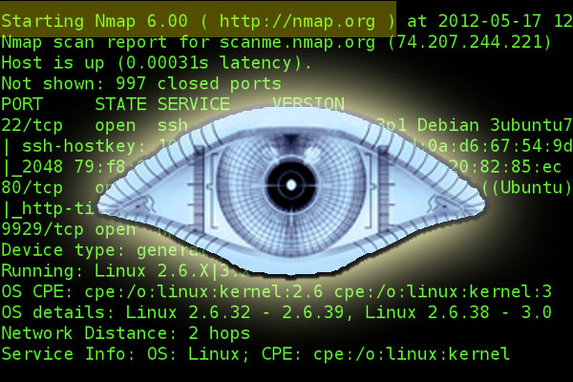
Initial Recon
IP: 192.168.0.128
Netmask: 255.255.255.0
Ping Sweep nmap -sn <IP>/<CIDR>
Port/Service scan (nmap -sV <IP>)
Notes:
Service scan tells you what services are running and what versions they are.

Slide 8

GET MORE INFORMATION!!!
Nmap scripts! (nmap -sC <IP>)
Exploit-db (Also Common Vulnerability and Exposures (CVE))
Google!! (Please use search engines I beg)
Hacktricks
Take information you have gathered and start to build a profile of the target. Look at EVERYTHING! This process is called enumeration
Notes:
-sC runs default scripts. Default scripts can be found at https://nmap.org/nsedoc/categories/default.html
Exploit-DB

Slide 9
Tools for info gathering (hint hint)
Nmap / rustscan
Ffuf (directory fuzzing,web)
Nikto (web vulnerability checker)
Manual enumeration of publicly accessible files
Notes:
-sC runs default scripts. Default scripts can be found at https://nmap.org/nsedoc/categories/default.html
Exploit-DB

Slide 10
Initial Compromise
You now have a rough idea on what your target is running. Look to see if these services are exploitable.
Use exploit DB and a CVE database to find if versions are vulnerable to exploits (e.g. CVE-2017-0144).
Try and misuse the services (For example, can you login without a password?)
Once you have found a way, attack it!
Notes:
-sC runs default scripts. Default scripts can be found at https://nmap.org/nsedoc/categories/default.html
Exploit-DB

Slide 11
Establish Foothold
You have access to a machine! Well done. Now you need to keep it. Any ideas?
Methods include:
Generating new SSH keys
Creating a new user (with SSH keys)
Establishing a C2 channel (advanced)
This is called Persistence. I could easily do a whole talk on this (many methods are available)

Slide 12
Privilege Escalation
This again could be a whole talk to itself!!
Privesc is becoming another user who has more privilege than your current one. On Linux systems, your end goal is root.
Common methods:
Misconfigured sudo permissions (sudo -l) (GTFObins)
Misconfigured SUID binaries (find / -perm /4000 2>/dev/null)
PATH manipulation
Misconfigured sensitive file permissions
Plaintext creds
Notes:
Hacktricks linux privesc cheatsheet: https://book.hacktricks.xyz/linux-hardening/linux-privilege-escalation-checklist

Slide 13
Lateral Movement
Lateral Movement is moving from one device to another (also known as pivoting although this is usually when you move between networks)
You can use the device you have compromised to find other devices on the network and attack them to gain more control.
You may have access to an internal network that is not publicly accessible from this machine. At this point you would begin enumerating again!

Slide 14
Privilege Escalation
Tools:
Linpeas (probably the best one)
Exploit-db (kernel exploits e.g. DirtyCOW)
GTFOBins - amazing website for listing how to exploit misconfigured binaries
Notes:
Hacktricks linux privesc cheatsheet: https://book.hacktricks.xyz/linux-hardening/linux-privilege-escalation-checklist
https://gtfobins.github.io/

Slide 15
Scenario
You are attacking a machine with the IP of 192.168.1.100 What should we do first?
Port/Service scan reveals that Port 21 (FTP) is open
FTP version VSFTPD v2.3.4 is running on Port 21
VSFTPD v2.3.4 is vulnerable to CVE-2011-2523 and a metasploit module exists

Slide 16
Scenario
Running the metasploit module gives you a shell as root. Should you stop here?
NO!!! Do network scans, see if there is any internal ports (Databases often don’t have their ports open externally, you may be able to find some fun stuff in databases), try and compromise another machine!

Slide 17
Recap
Enumerate EVERYTHING!
When doing CTFs (like your about to do!) they are designed to be vulnerable. If you haven’t found the vulnerability yet, you haven’t looked at everything
Google everything. Not sure what a port is? Google it. Not sure what X command does? Google it
It’s not always as easy as point and click

Slide 18
Waffle Slide (may help with practical)
If linpeas doesn’t work manually enumerate stuff
Users, groups, writable files that shouldn’t be writable
Check what users are on the machine (cat /etc/passwd)
Some passwords may be hashed such as /etc/shadow hashes
Encrypted SSH keys can be cracked with John The Ripper
(Lookup SSH2John)
USE HACKTRICKS CHECKLIST AND GOOGLE
USE GTFOBINS
Plus anything else I remember while waffling :-)

Slide 19



Your turn!
https://tryhackme.com/jr/impetum
Notes:
Practical is completable from the attack box or over ovpn.

